Slide 1

COMPANIES AND GEOPOLICAL RISKS
2025-2026
OMRI Yassine

Slide 2
IV. Syrian Case

Slide 3
IV. Syrian Case : Syria by Maps
Syria
Geography
Populations
Ethnic groups
Religions
Military wars
Gaz and petrol : pipelines
Theory of 4 seas
La Farge in Syria

Slide 4
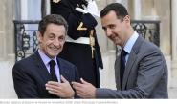
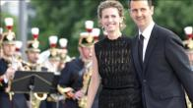
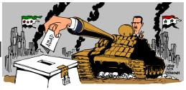
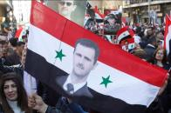
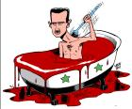

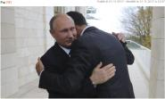
1. Syria
President : BACHAR AL-ASSAD
Area : 185.000 km²
change: Syrian Pound (0.004€)
Population: 18.3 Millions

Slide 5
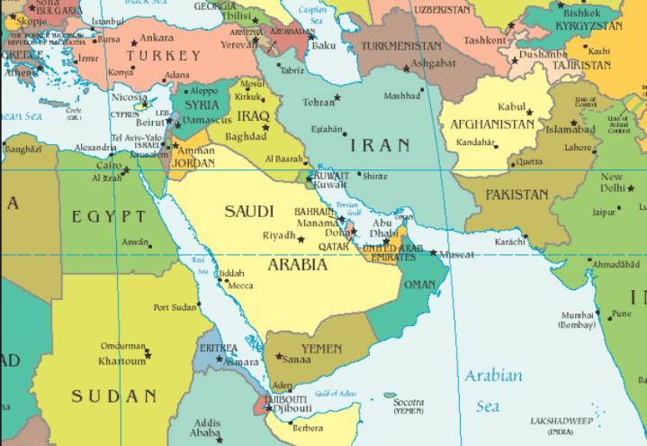
2. Geography

Slide 6
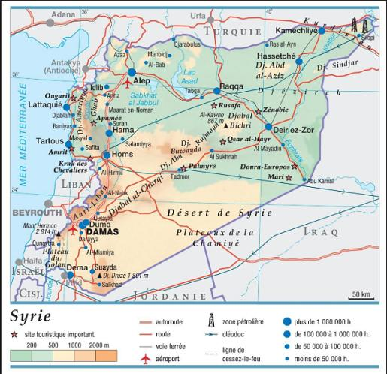
2. Geography

Slide 7
3. Populations a) Ethnic groups

Slide 8
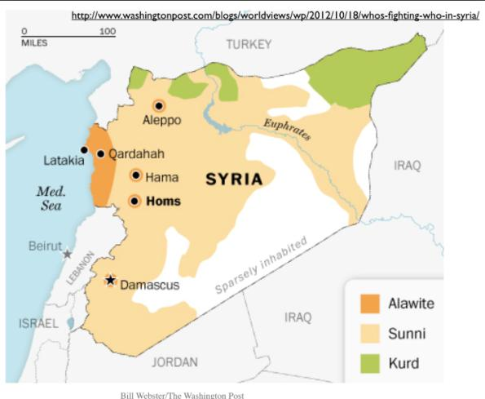
a) Ethnic groups

Slide 9
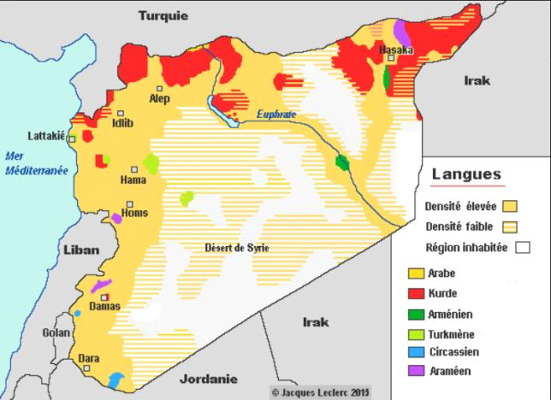
a) Ethnic groups

Slide 10
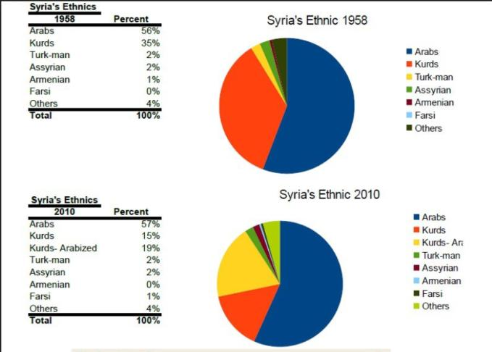
a) Ethnic groups

Slide 11
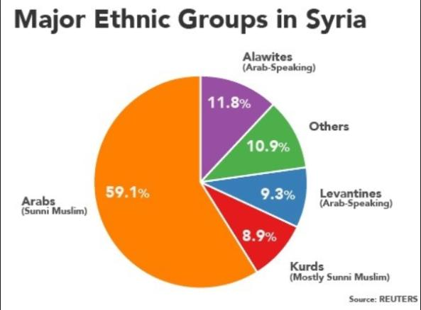
a) Ethnic groups

Slide 12
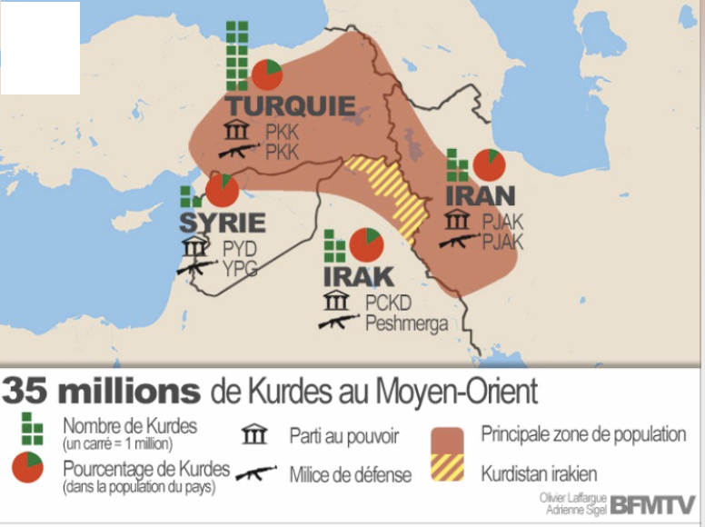
a) Ethnic groups

Slide 13
3. Populations a) Religions

Slide 14
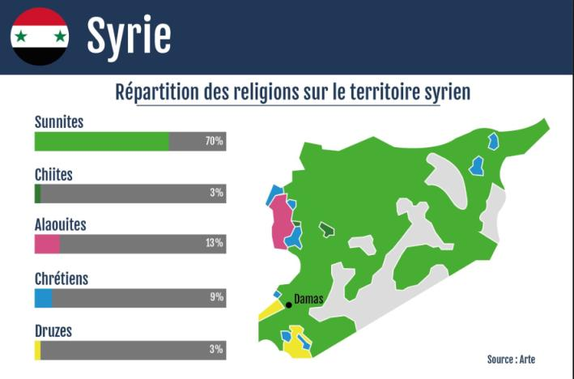
b) Religions

Slide 15
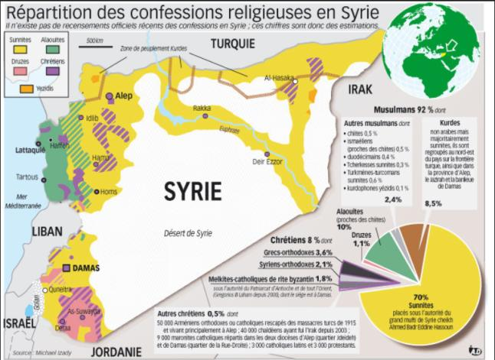
b) Religions

Slide 16
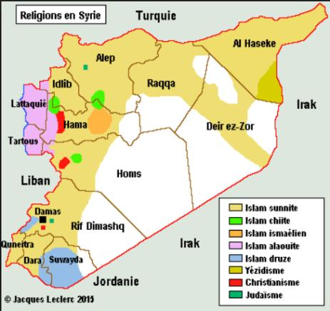
b) Religions

Slide 17
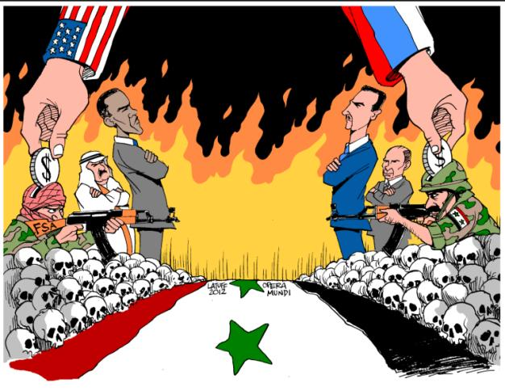
4. Military wars

Slide 18
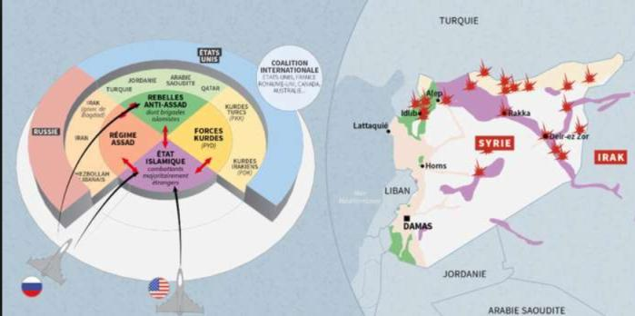
4. Military wars
https://www.lemonde.fr/proche-orient/video/2015/10/27/comprendre-la-situation-en-syrie-en-5-minutes_4798012_3218.html
Video :

Slide 19
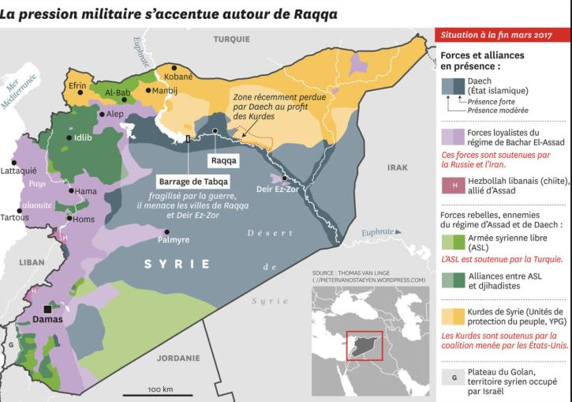
4. Military wars

Slide 20
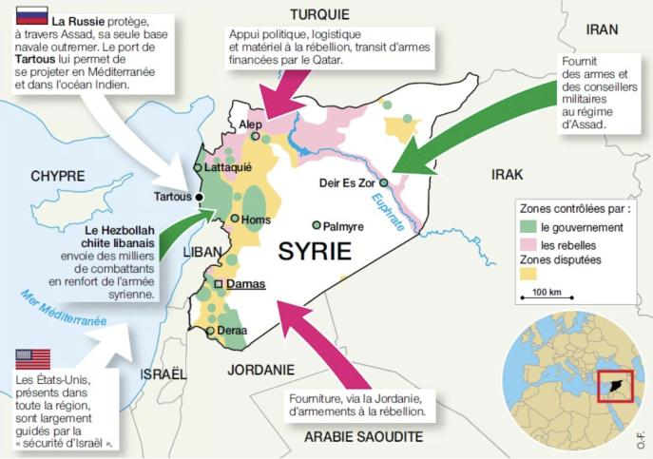
4. Military wars

Slide 21
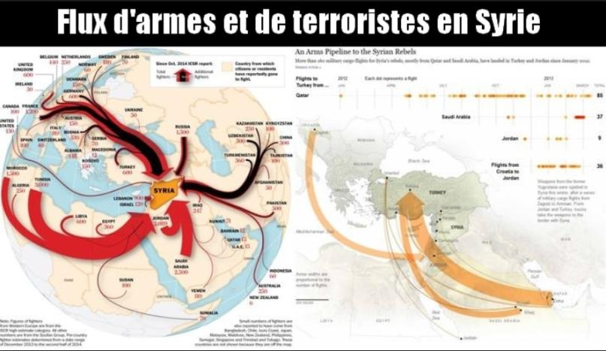
4. Military wars

Slide 22
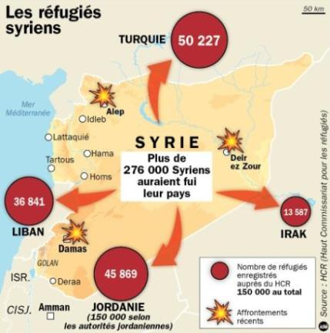
4. Military wars

Slide 23
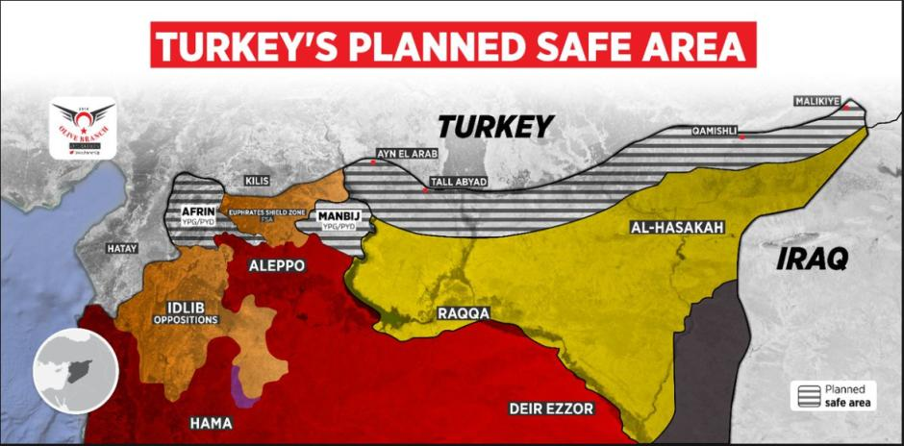
4. Military wars

Slide 24
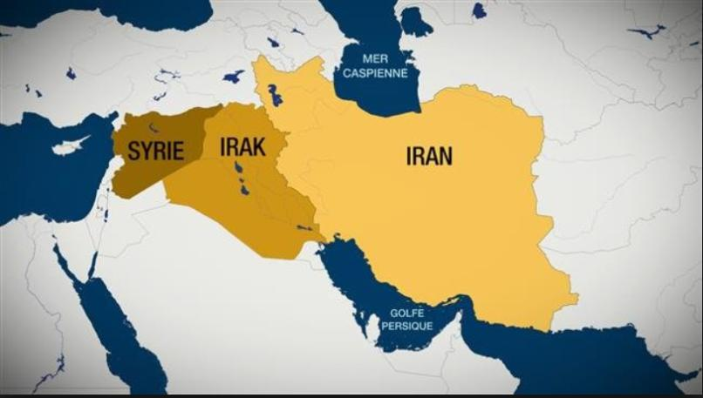
4. Military wars

Slide 25
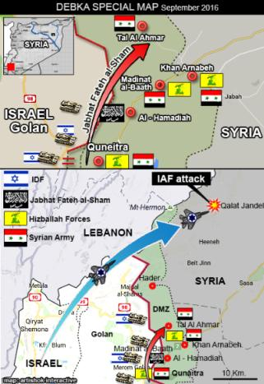
4. Military wars

Slide 26
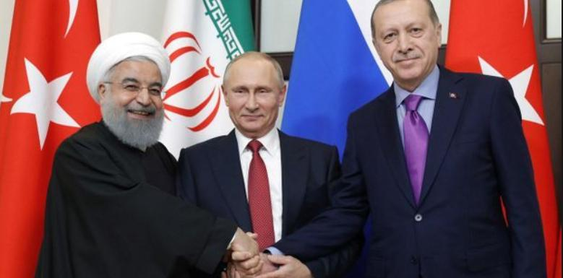
4. Military wars

Slide 27
5. Gaz and petrol : pipelines

Slide 28
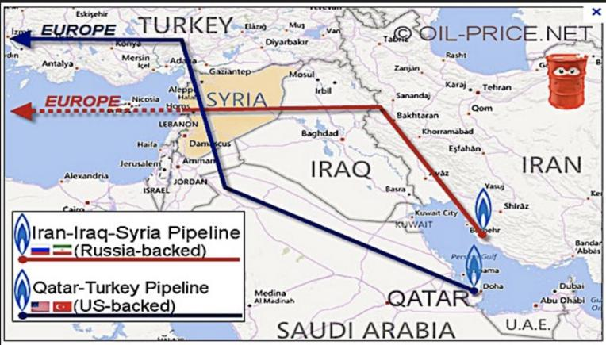
5. Gaz and petrol : pipelines

Slide 29
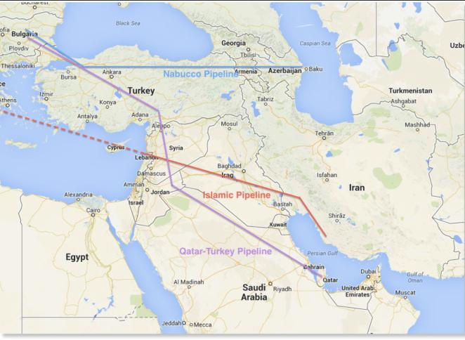
5. Gaz and petrol : pipelines

Slide 30
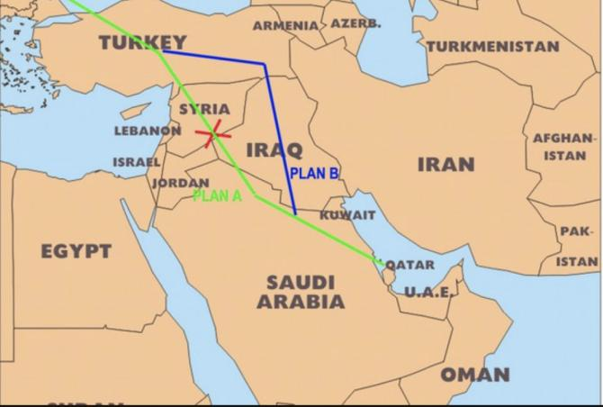
5. Gaz and petrol : pipelines

Slide 31
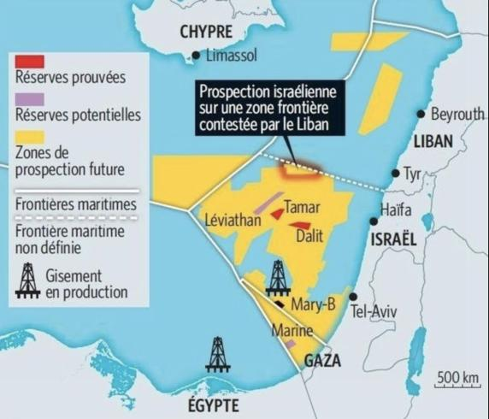
5. Gaz and petrol : pipelines

Slide 32
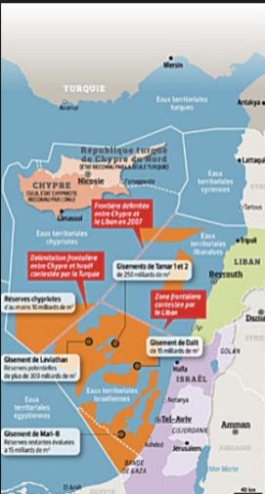
5. Gaz and petrol : pipelines

Slide 33
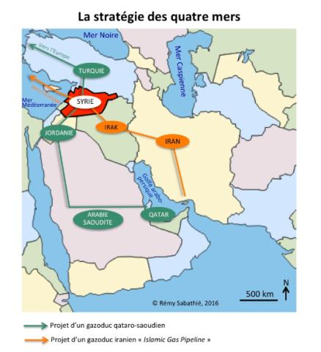
6. Theory of 4 seas

Slide 34



7. Lafarge in Syria
https://www.youtube.com/watch?v=EpH65n0r7pM
Article : https://www.lemonde.fr/societe/article/2018/06/28/financement-du-terrorisme-lafarge-sa-mise-en-examen-pour-complicite-de-crimes-contre-l-humanite_5322647_3224.html
Video :

